Slide 1















ROUND 2
CASE STUDY
Billy Truong

Slide 2



EXECUTIVE SUMMARY: Pizza Hut RFM Analysis
Objective: This RFM analysis project aims to segment Pizza Hut's customer base based on Recency, Frequency, and Monetary Value (RFM) to gain insights into customer behavior, identify high-value customers, and inform targeted marketing strategies.
Methodology: We analyzed historical purchase data of Pizza Hut customers, segmented them into RFM clusters, and assessed their characteristics and purchase patterns.
Key Findings:
Customer Segmentation: Eight distinct RFM segments were identified: Champion, Loyal Customers, Promising, New Customers, Shouldn’t Lose Customers, Need Attention Customers, Sleepers, and Lost.
Value Drivers: Frequency and Monetary Value were identified as the primary drivers of customer lifetime value (CLV). Loyal Champions and Frequent Value Seekers contribute the highest CLV.
Churn Risk: Lapsed High Spenders and Price-Conscious Drifters show higher churn risk and require targeted retention strategies.
Marketing Opportunities: Recommendations include personalized promotions and targeted campaigns based on RFM segments to increase customer engagement, drive higher purchase frequency, and retain valuable customers.
Impact: Implementing these RFM segmentation insights can help Pizza Hut:
Optimize marketing campaigns: Target different segments with relevant offers and messaging to increase campaign effectiveness.
Improve customer retention: Identify and implement targeted retention strategies for at-risk segments.
Boost customer lifetime value: Focus on high-value segments and encourage repeat purchases.
Gain deeper customer understanding: Utilize RFM insights to inform product development and service offerings.

Slide 3


TABLE OF CONTENTS
DATA PREPARATION AND PRECISON
DATA ANALYSIS AND INSIGHTS
BUSINESS QUESTIONS
RECOMMENDATIONS

Slide 4
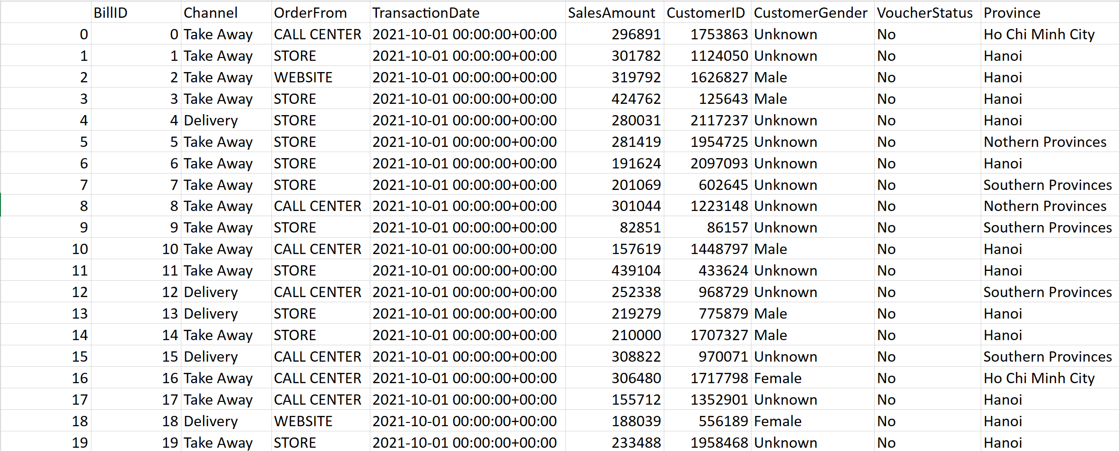
1/ DATA PREPARATION AND PRECISION
Raw data looks like:

Slide 5
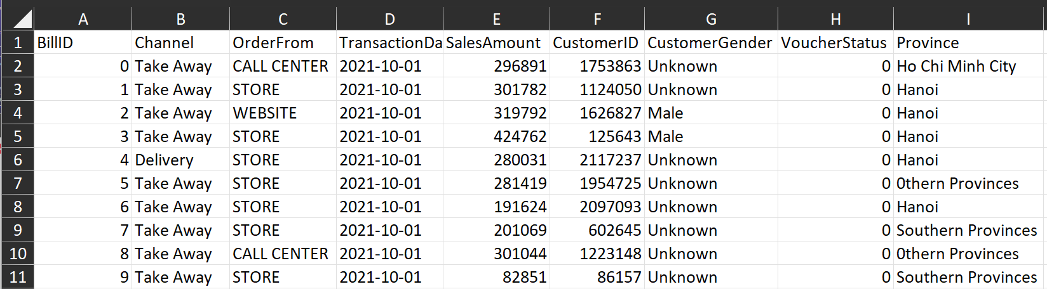
1/ DATA PREPARATION AND PRECISION
Data Normalization process:
1/ Reduce redundancy: Column A has exactly the same value with Column B: BillID
2/ Format “TransactionDate” data type to Date.
3/ Replace misspelled typo: “Ha0i” -> “Hanoi”, and “Unk0w” -> “Unknown”
New Data look like

Slide 6
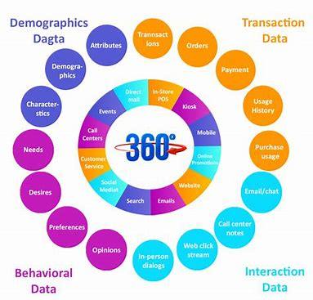
2/ DATA ANALYSIS AND INSIGHTS
Customer 360:
Helps company understand customers portrait.
Dives deeply into data to enhance customer’s satisfaction.

Slide 7
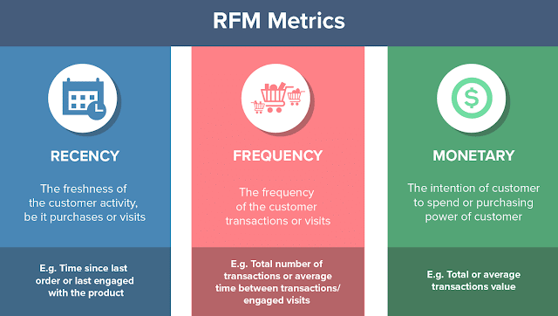
RFM ANALYSIS
Using data from Customer 360, we can create a RFM Analysis based on 3 categories:
R: Recency – How long since last purchase was made. (Datediff Last TransactionDate – Today)
F: Frequency – How many purchases were made in total. (Count Distinct TransactionDate)
M: Monetary – Total Amount of Money was spent in total. (Sum SalesAmount)

Slide 8
RFM CALCULATION
SCORE | Min 0 | 25% 1 | Median 2 | 75% 3 | Max 4
Recency (Days since last purchase) | 803 | 674 | 555 | 439 | 338
Frequency (How many purchases) | 1 | 1 | 2 | 2 | 181
Monetary (VND) | 7,148 | 201,287 | 311,815 | 567,476 | 133,774,476
- Using statistical mathematics, we calculate Min, 25%, Median, 75%, and MAX of R,F and M.
- Score from 1-4 ( Worst to best)
1 – Min to 25%
2 – 25% to Median
3 – Median to 75%
4 – 75% to Max
- Combine R,F,M to get RFM Score. Ex: RFM = 444, RFM = 323
Example:
Customer A last purchased a Pizza
1 year ago (365 days R =4),
bought 10 times (F =4),
with total Sales: 1,000,000 VND (M=4)
=> RFM = 444

Slide 9
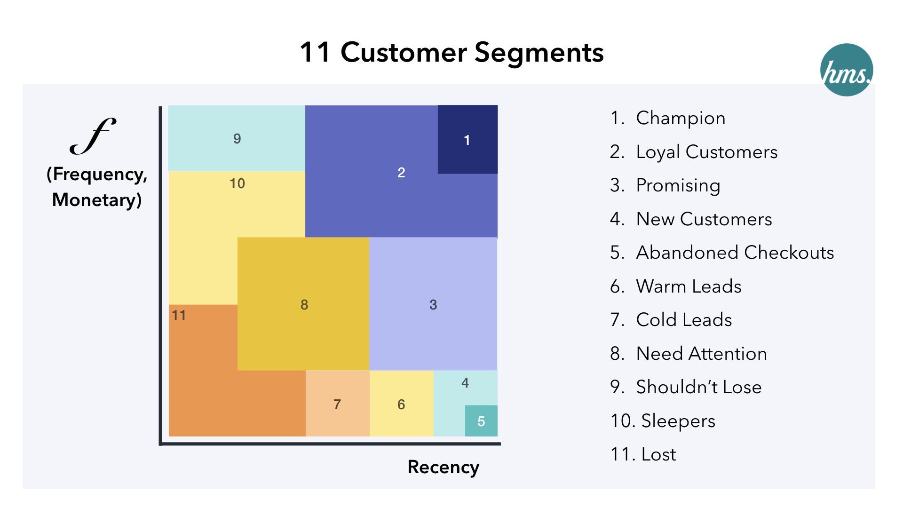
RFM SEGMENTATION
Based on RFM Score, categorize customers into different segmentations to provide appropriate services
SEGMENTATION | RFM SCORE
Champion | 444
Loyal Customers | 344;244;343;443;234
Promising | 412;413
New Customers | 411
Shouldn’t Lose | 311;321;322;312
Need Attention | 232;323;233;231
Sleepers | 122;121;123
Lost | 111;112

Slide 10
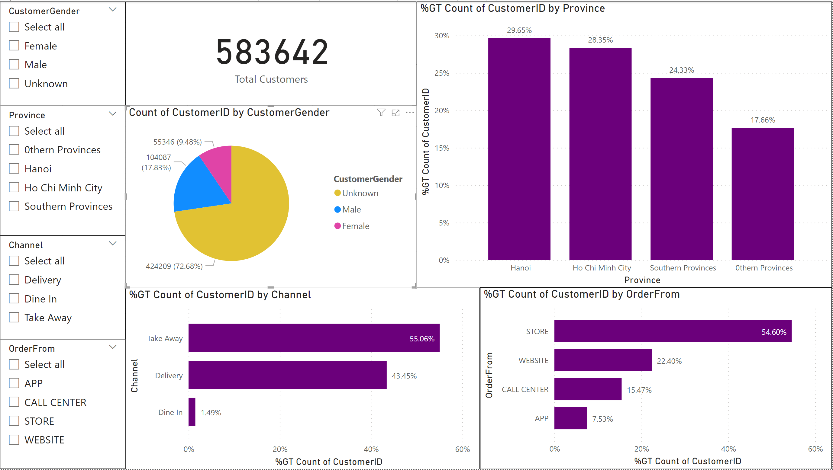
BUSINESS QUESTION 1:
1/ Describe the portrait of customers and provide insights into their behavior :
Who are the people buying products ?

Slide 11
BUSINESS QUESTION 1:
1/ Describe the portrait of customers and provide insights into their behavior :
Who are the people buying products ?
- Data is from Jan 1st 2021 - Dec 31st 2023
- Total Customers: 583,642
Categorized by Gender: 17.83% is Male, 9.48% is Female, and 72.68% is unknown
Categorized by Geography: 29.65% from Hanoi, 28.35% is from Ho Chi Minh city, 24.33% is from Southern Provinces, 17.66% is from Othern Province
Categorized by Channel: 55.06% is Take Away, 43.45% is Delivery, only 1.49% Dine in
Categorized by Order From: 54.60% order from Store, 22.40% order from Website, 15.47% order from Call Center, only 7.53% order from App

Slide 12
BUSINESS QUESTION 1:
b/ Which location do they live in?
- Categorized by Geography: 29.65% from Hanoi, 28.35% is from Ho Chi Minh city, 24.33% is from Southern Provinces, 17.66% is from Othern Province.
- Customers in Hanoi:
55.29% Take Away, 43.23% is Delivery, only 1.47% Dine in
55.64% Order from Store, 21.35% order from Website, 15.33% order from CallCenter, 7.68% order from App
- Customers in Ho Chi Minh:
57.24% Take Away, 40.87% is Delivery, only 1.89% Dine in
30.37% Order from Store, 37.60% order from Website, 22.03% order from CallCenter, 10% order from App
=> Customers DON’T like Dining in.
=> Customers in Ho Chi Minh order from Website, Call Center, and App MORE than Customers in Hanoi

Slide 13
BUSINESS QUESTION 1:
c/ Which channel are they purchasing from?
- Categorized by Channel: 55.06% is Take Away, 43.45% is Delivery, only 1.49% Dine in
- Customers in Hanoi:
81.68% order from Store and take away.
11.10% order from Website and Takeaway.
3.69% and 3.53% order from CallCenter and App.
- Customers in Ho Chi Minh:
60.22% order from Store and take away.
25.48% order from Website and take away.
9.25% and 5.06% order from Callcenter and App.
- 100% customers Dine in order from Store
=> We can still see Customers in Ho Chi Minh prefer using Website, Call Center, and App more than Customers in Hanoi.

Slide 14
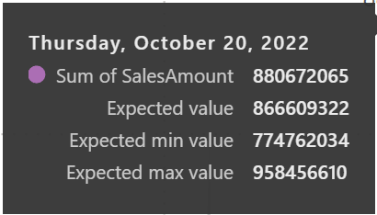
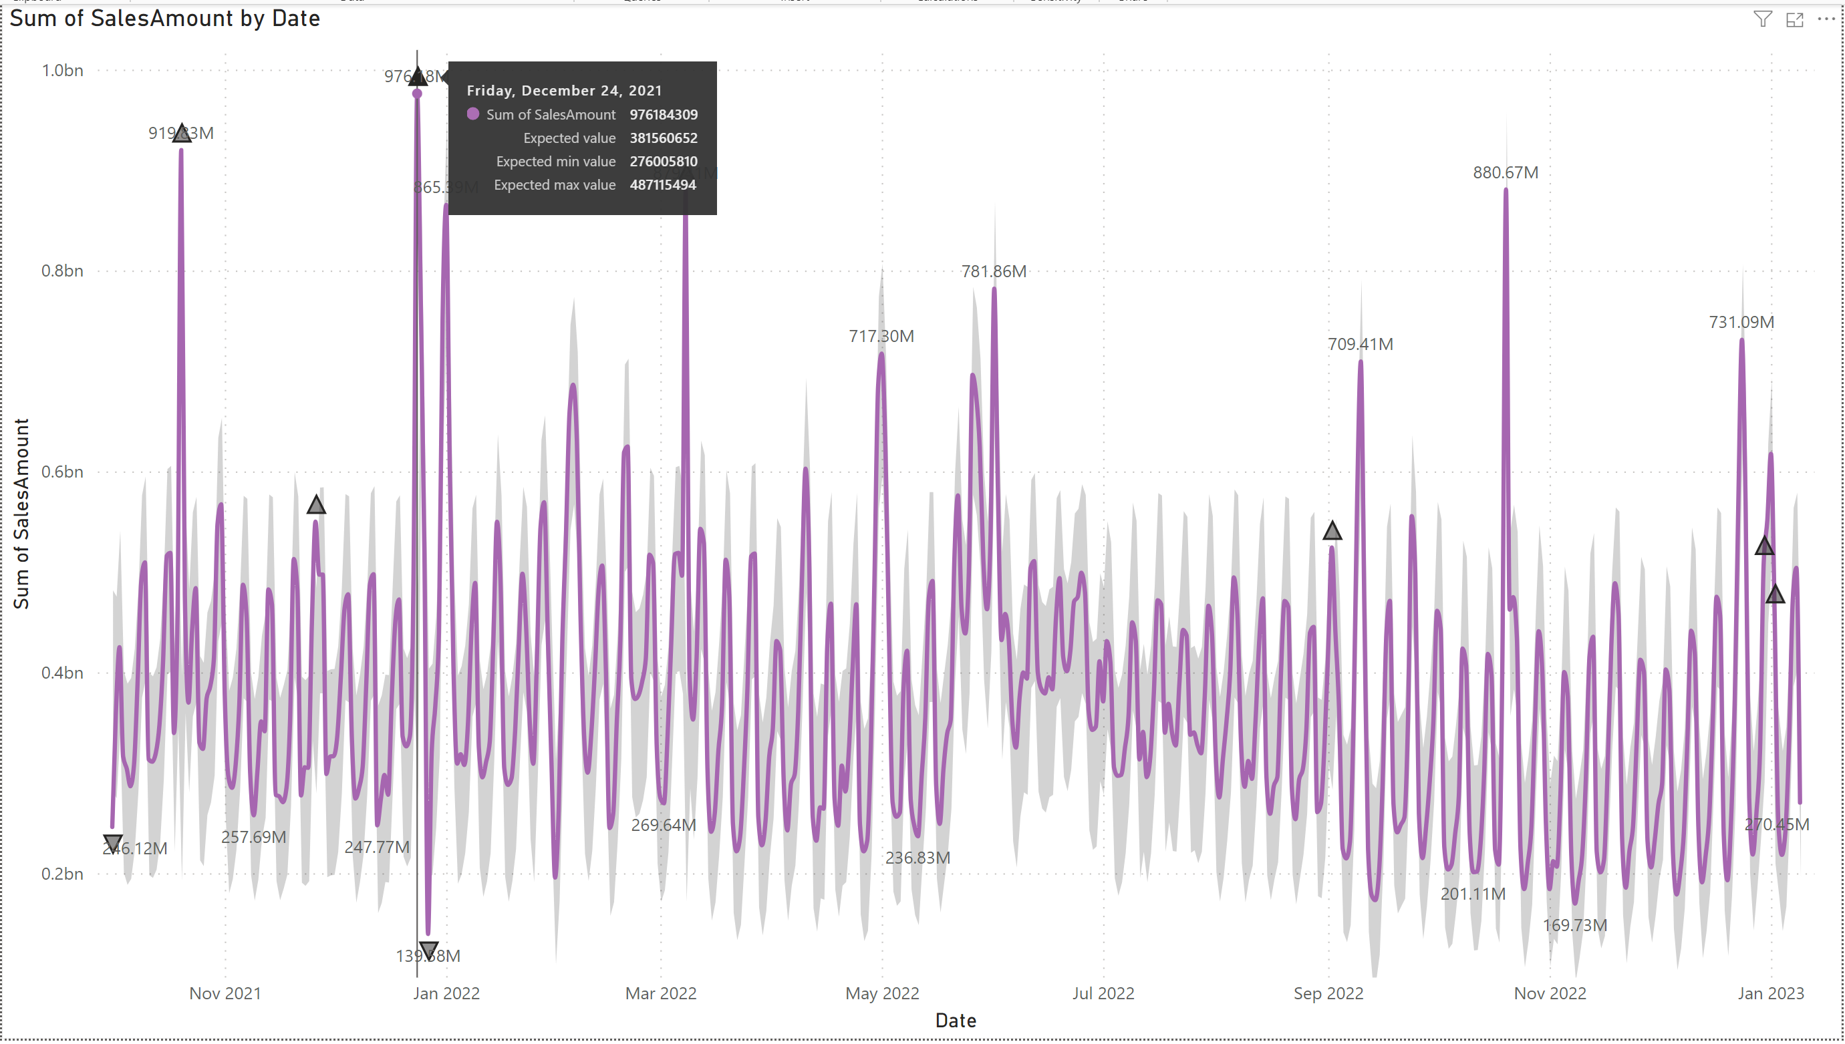
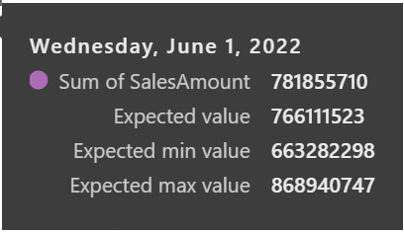
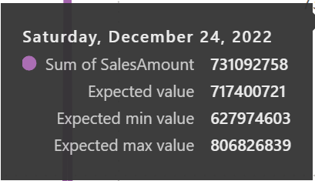
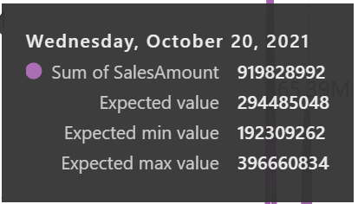
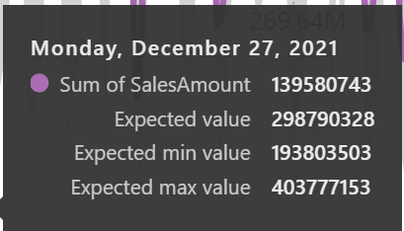
BUSINESS QUESTION 1:
d/ What makes them buy?

Slide 15
BUSINESS QUESTION 1:
Based on the line chart,
High Peaks are on Friday, Saturday and Sunday (Weekends)
Low peak is in Weekday, especially Monday and Tuesday after high peak
Customers prefer eating Pizza in the weekends.
Customers don't eat Pizza 2 consecutive days.
Significant high peaks are on Holidays:
Wed, Oct 20th,2021: Vietnamese Women days: 919M in Sales
Sat, Nov 20th, 2021: Teacher days
Fri, Dec 24t, 2021: Christmas: 976M in Sales
Sat, Jan 1st, 2022: New Year: 865M in Sales
Tues, Mar 8th, 2022: International Women days: 879M in Sales
Sat, Apr 30th, 2022: Independent Day 684M
Sun, May 1st, 2022: Labor day 717M in sales
Wed, Jun 1st, 2022: Children Days: 781M in Sales
Thurs, Oct 20th, 2022: Vietnamese Women days: 880M in sales
Sun, Nov 20th, 2022: Teacher days
Sat, Dec 24th, 2022: Christmas: 731M
Sun, Jan 1st 2023: New Year
Customers prefer eating Pizza in Holidays

Slide 16
BUSINESS QUESTION 2:
Using RFM Model, segment customers into different groups
SEGMENTATION | RFM SCORE
Champion | 444
Loyal Customers | 344;244;343;443;234
Promising | 412;413
New Customers | 411
Shouldn’t Lose | 311;321;322;312
Need Attention | 232;323;233;231
Sleepers | 122;121;123
Lost | 111;112

Slide 17
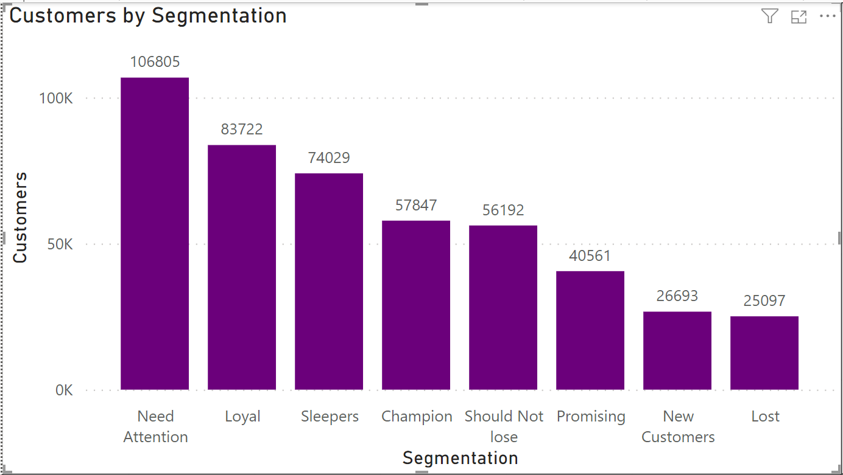
BUSINESS QUESTION 2:
Total of 583,642 Customers are divided into 8 segmentations
Need Attention: 106,805 customers (22.68%)
Loyal: 83,722 customers (17.78%)
Sleepers: 74,029 customers (15.72%)
Champion: 57,847 customers (12.28%)
Should Not Lose: 56,192 customers (11.93%)
Promising: 40,561 customers (8.61%)
New Customers: 26,693 customers (5.67%)
Lost: 25,097 customers (5.33%)

Slide 18
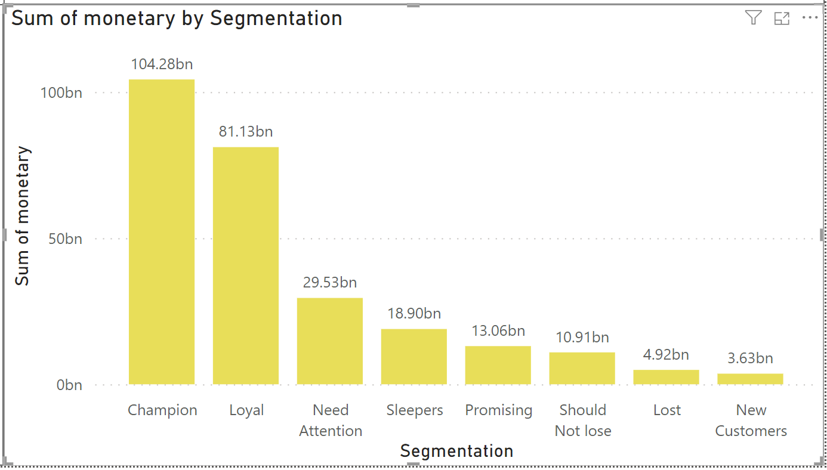
BUSINESS QUESTION 2:
Categorized by Monetary:
Champion – 104.28 BN VND in Sales, 39.15%
Loyal – 81.13 BN VND in Sales, 30.46%
Need Attention – 29.53 BN VND in Sales, 11.09%
Champion has 57,847 Customers (12.28% customers) but contribute 104.28 Bn VND in Sales,39.15% total Revenue
Loyal Loyal: 83,722 customers (17.78% customers) but contribute 81.13 BN VND in Sales, 30.46% total Revenue
Need Attention: 106,805 customers (22.68% customers) but only contribute 29.53 BN VND in Sales, 11.09%

Slide 19
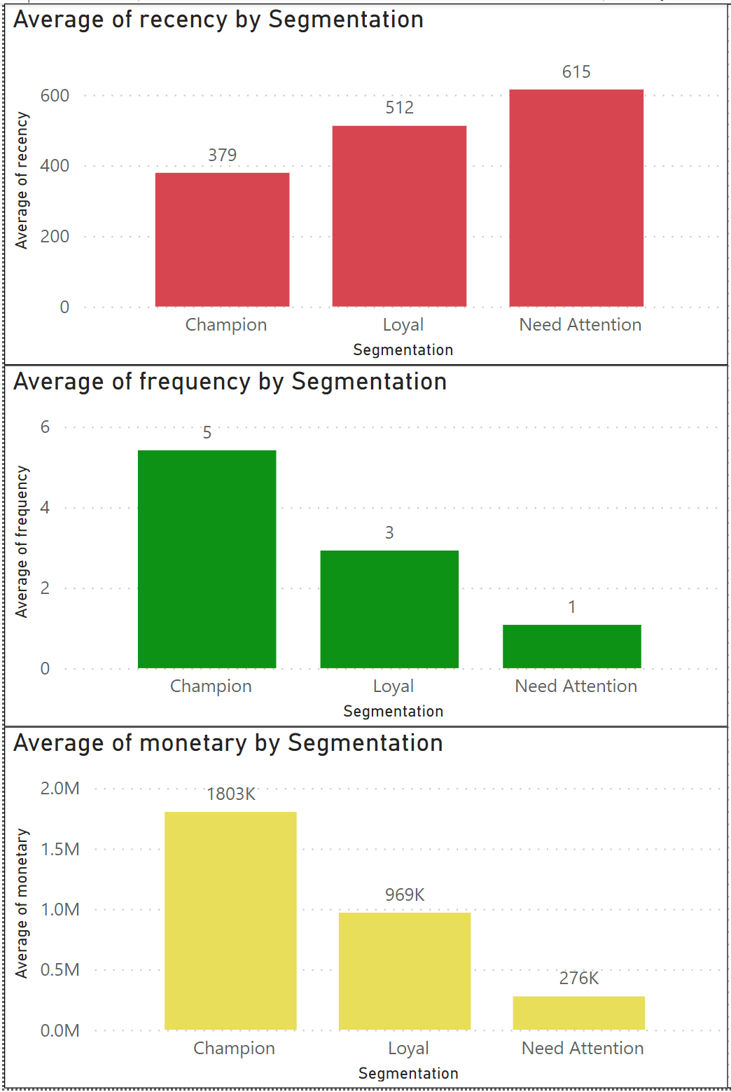
BUSINESS QUESTION 2:
By Average Recency:
Champion last purchases were 379 days ago (1 year)
Loyal last purchases were 512 days ago (1 year 4 months)
Need attention last purchases were 615 days (1 year 8 months)
By Average Frequency:
Champion customers buy 5 times
Loyal customers buy 3 times
Need Attention customers only buy 1 time
By Average Monetary:
Champion customers average value: 1.8 M VND/ purchase
Loyal customers average value: 969K VND/ purchase
Need Attention customers average value: 276K VND/ purchase

Slide 20
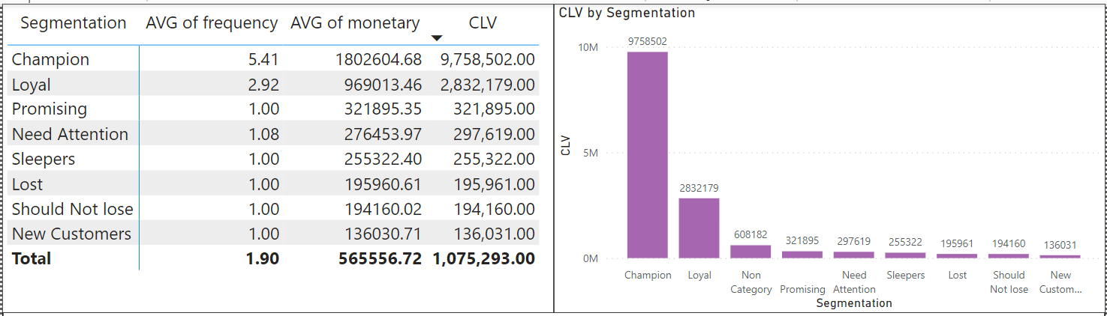
BUSINESS QUESTION 3:
Customer Life value (CLV) = Avg Frequency * Avg Monetary (For each Segmentations)

Slide 21
BUSINESS QUESTION 4: RECOMMENDATIONS
How to engage and attract new customers or lapers?
Based on insights found:
Customers prefer eating Pizza in the weekends and don’t eat pizza 2 consecutive days.
Customers prefer eating Pizza in Holidays.
Possible reasons:
Price
Pizza is considered “Unhealthy Food”
Eating Habit: Pizza cannot replace a regular meal in Vietnamese culture.
Solutions for problem 1: Price and encourage customers consume more Pizza during weekday.
Referral discount for both Old and New Customers (50% discount or free 1 pizza in next order)
Voucher (valid only from Monday – Thursday and excluded from other promotion) for an order from App and Website (Encourage customers using App and Website more, so we have more data to analyze customers portrait)
Having 1 day of a week for ‘Buy 1 get 1 free on selected Pizza’ (Recommend Wednesday because it’s the middle of the week, and customers don’t eat pizza 2 consecutive days. Also, help up-sale with higher price Pizza).

Slide 22
BUSINESS QUESTION 4: RECOMMENDATIONS
How to engage and attract new customers or lapers?
Solutions for problem 2: Pizza is considered “Unhealthy Food”
Make healthy Pizza: Less oil, less salt, add more vegetable (Can approach to vegans as new customers)
Reduce size of pizzas so that less calories per pizza consumption
With Lapsers or Sleepers:
Customers has MIN Recencay: 338 days (almost 1 year without ordering anything)
We can remind them with a birthday Voucher for 1 free pizza (must dine-in at store and bring 2 more friends) (approach more customers and with 3 people, they’ll order 2-3 pizzas)
Launch a 2-3 months campaign: “Awakening all Lapsers” with 1 free pizza (must dine-in at store and bring 2 more friends)

Slide 23
BUSINESS QUESTION 4: RECOMMENDATIONS
b. How to increase frequency for repeated users?
Launch a Rewarding program:
When customer buy pizza, they’ll receive points. At certain point level, they’ll be promoted to different ranks: Bronze, Silver, Gold, Platinum, Diamond. With different priviledges ex: Higher discount rate, priority waiting line, guaranteed delivery time, private lounge, better customer service, birthday celebrating for them and their family, etc …
2. Sending emails, letters, announcements on newest Promotion program, Voucher, …

